Slide 1
COFFEE WITH THE COUNSELORS
The effects of depression, anxiety, and motivation on Mental Health.
By Rachquel Hills, MHHS Psychologist

Slide 2
What Will Be Covered
Understanding Mental Health
Factors that impact Mental Health
Mental Health and Depression
Mental Health and Anxiety
Mental Health and Motivation
Factors to improve wellbeing
Resources to screen Mental Health

Slide 3
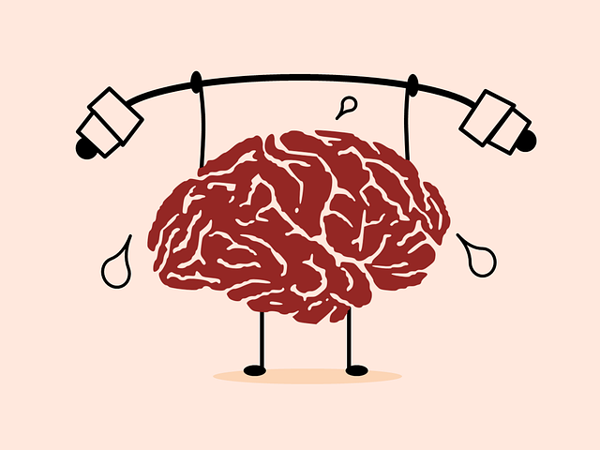
Understanding Mental Health
Mental health is a positive concept related to the social and emotional wellbeing of people and communities. The concept relates to the enjoyment of life, ability to cope with stress and sadness, the fulfilment of goals and potential, and a sense of connection to others.

Slide 4
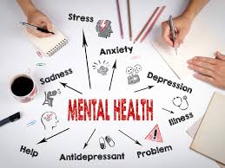
Understanding Mental Health
Our mental health directly influences how we think, feel and act: it also affects our physical health. Work, in fact, is essentially one of the best things for protecting our mental health, but it can also adversely affect it.

Slide 5
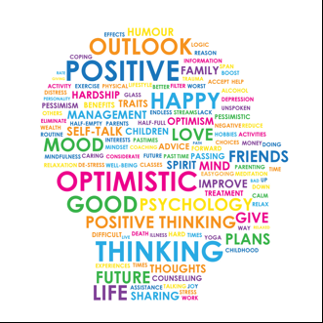
Factors that impact Mental Health
Everyone experiences down times in life. The ability to cope with negative experiences varies greatly from one person to another and determines whether people enjoy their lives.
Some of the factors that affect mental health are:
* Self-esteem
* Feeling loved
* Confidence

Slide 6
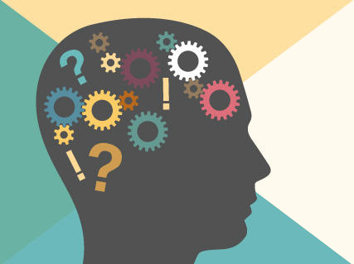
Factors the impact Mental Health
* Family Breakup or loss
* Difficult Behavior
* Physical Health
* Abuse
* Economic Distress
* Worldwide Epidemics

Slide 7
Depression
Depression is a constant feeling of sadness and loss of interest, which stops you doing your normal activities.
Different types of depression exist, with symptoms ranging from relatively minor to severe.
Normally, depression does not result from a single event, but from a mix of events and factors.

Slide 8
Anxiety
Anxiety is your body's natural response to stress.
It's a feeling of fear or apprehension about what's to come. The first day of school, going to a job interview, may cause most people to feel fearful and nervous.

Slide 10
Mental Health and Motivation
Motivation is one of the driving forces behind human behavior. It fuels competition and sparks social connection. Its absence can lead to mental illnesses such as depression and anxiety.
Motivation is something that we use every day. It's what enables us to survive - to get food because we're hungry, to go to work to pay the bills or to educate ourselves in order to pursue a higher goal in life.
How we respond to life's demands can affect our overall health

Slide 11
Factors to improve Mental Health

Slide 12
Resources to screen Mental Health
For parents: https://screening.mhanational.org/screening-tools/parent/?ref=MHANI
For youth: https://screening.mhanational.org/screening-tools/youth/?ref=MHANI
For anxiety: https://screening.mhanational.org/screening-tools/anxiety/?ref=MHANI
For depression: https://screening.mhanational.org/screening-tools/depression/?ref=MHANI

