Slide 1
Nursing
So many options…

Slide 2
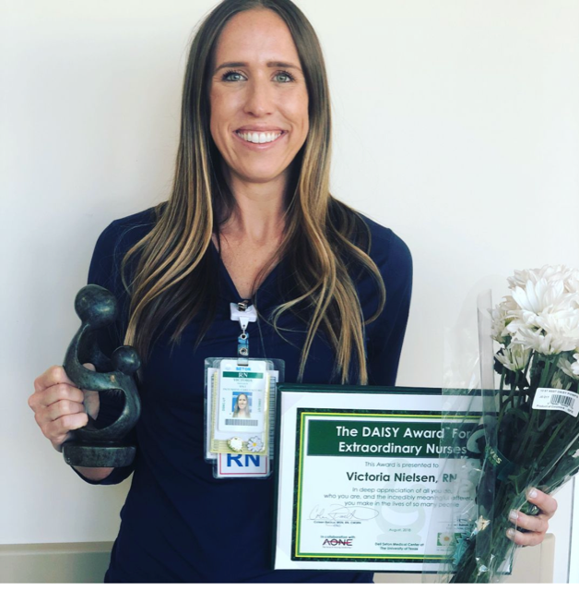
ABOUT ME
I took a longer route to nursing…
EDUCATION
Cal Poly Pomona- Bachelor’s degree in Apparel Merchandising and Management
Austin Community College- Completed required courses to apply for nursing school
Azusa Pacific University- Bachelor’s degree in Nursing
WORK EXPERIENCE
Nurse for 6 years- 3 years as a staff nurse + 3 years as a travel nurse
ICU Nursing- Medical ICU, Surgical ICU, Neuro ICU, Neurosurgery ICU, Trauma, Burn ICU, Cardiac ICU

Slide 3
EDUCATION
Required To Become a Nurse:
Option 1: Associates Degree- about 2 year, minimum requirement to be a nurse
Option 2: Bachelors Degree- about 4 years, required by most Magnet Hospitals and preferred
Accelerated programs offered
Pass the NLCEX test after nursing school

Slide 4
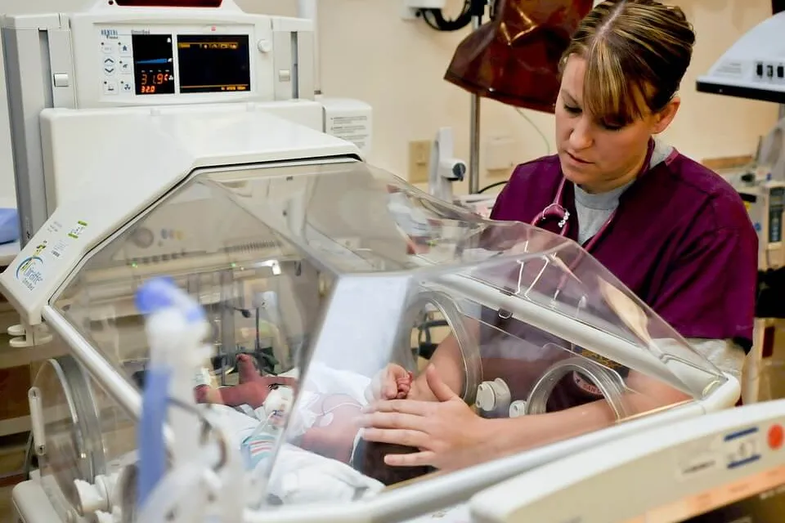
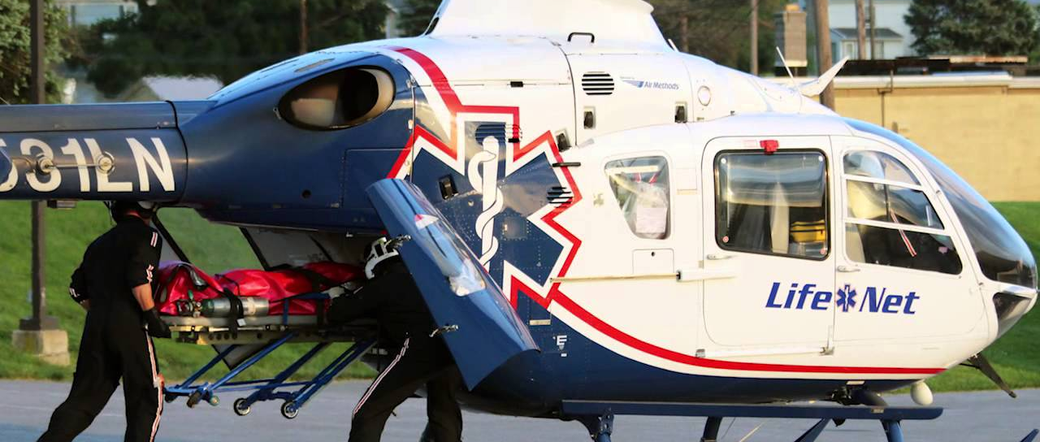
TYPES OF NURSES
Hospital Setting
School Nurse
Doctors' office
Organ Donation
Life Flight- transport patient by aircraft
Events- marathons, concerts, sports teams
Corporate- Google, Facebook
Travel- go where the needs are
Administrative

Slide 5
STAFF RN vs TRAVEL RN
Staff
Feel apart of the unit/team
Staff trust + know your nursing skills and knowledge
Make your own schedule
Familiar with procedures, protocols
Know your way around the hospital
Less pay
Travel
Must be flexible to float to other units
Staff do not know your nursing skills and judgement yet
Fill the scheduling needs
Must learn specific hospital procedures, protocols
Not familiar with hospital- CT, MRI, stock + medication rooms
Pays more

Slide 6
ADDITIONAL CERTIFICATIONS
BLS- Basic Life Support
ACLS- Advance Cardiac Life Support
PALS- Pediatric Advance Life Support
NIHSS- Stroke Certification, specific to stroke centers/hospitals
CCRN- Critical Care Certification- more extensive education for the ICU setting
This Photo by Unkown Author is licensed under CC BY-SA

Slide 7
WHAT MY DAY LOOKS LIKE
Start my 12hr shift at 6:45-7am for unit huddle
Get report from night shift nurse + learn about my pts- read notes, review orders
“Put eyes” on my pts, introduce myself and go over plan for the day with pts- check out lines/tubes/drains/wounds
Use my ‘brain’ to build a TO DO LIST- timed labs, medications, schedule tests (CT, MRI, Ultrasound)
Head to toe assessment at 0800, 1200, 1600
Morning ROUNDS- multidisciplinary rounds with attending ICU doctor, pharmacy, case manager, chaplain
Keep my charge/lead nurse updated with any changes/scheduled tests with my pt, change of status
Utilize my neighbor nurses and clinical nurse assist to help with baths and clean ups

Slide 8
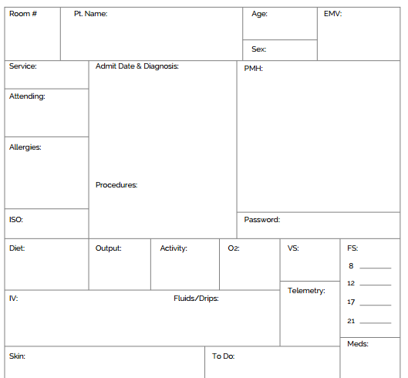
NURSING BRAIN

Slide 9
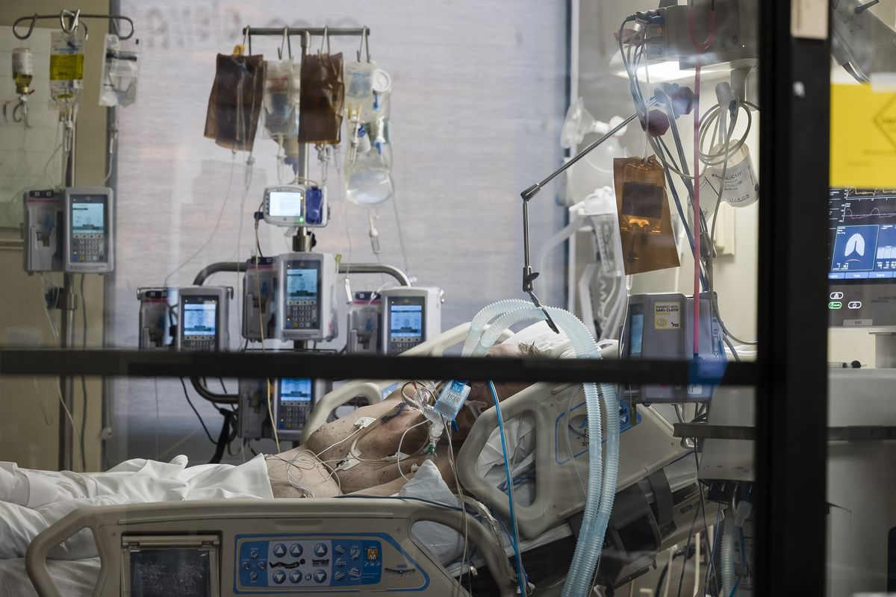
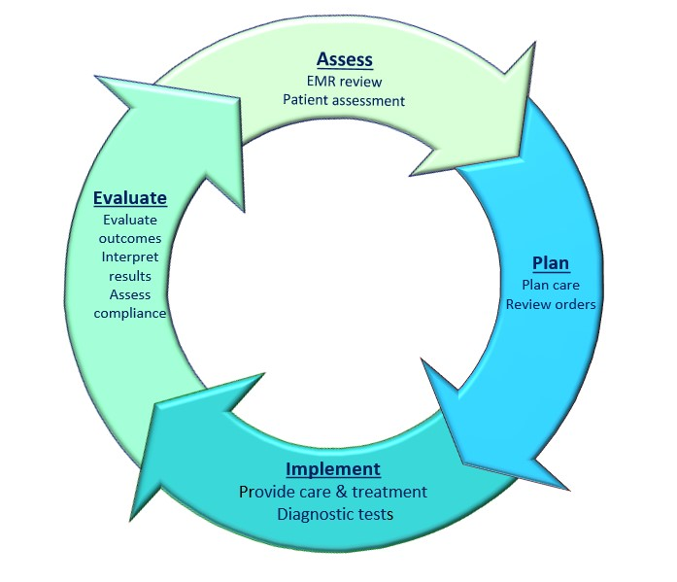

Slide 10
CONTINUING EDUCATION
Nurse Practitioner
Nurse Anesthetist
Nurse Researcher
Administrator

Slide 11
WHY I LOVE BEING A NURSE
Help People by caring for and educating patients and families
Constantly Learning and Evolving
Teamwork Centered/Family Atmosphere
Try Different Areas of Nursing
Flexibility + Creativity

Slide 12
INTERESTED IN NURSING?
Pick the brains of nurses you know, ask lots of questions
1
Shadow a nurse
2
Volunteer NOW at a hospital
3
Do well in school, nursing is competitive
4

Slide 13
ANY QUESTIONS??

